Slide 1

REPUBLIC OF CAMEROON
Peace-Work-Fatherland
MINISTER OF HIGHER EDUCATION
FACULTY OF ENGINEERING
AND TECHNOLOGY
REPUBLIC OF CAMEROON
Peace-Work-Fatherland
MINISTER OF HIGHER EDUCATION
FACULTY OF ENGINEERING
AND TECHNOLOGY
COURSE TITLE: Internet Programming and Mobile programming
COURSE CODE: CEF 440
DEPARTMENT: Computer Engineering
SUB-DEPARTEMENT: Software Engineering (SE)
INSTRUCTOR: Dr. KAMENI Valery
NAMES | MATRICULE
CHO WESLEY MUNGO | FE21A160
NTUI RAOUL NTUI RAOUL | FE21A288
ANANFACK ZANGO ANGELA CARINE | FE21A137
NKWETI MANGEM ANCELIA | FE21A280
ALAIN NKEH MBUNKUH | FE21A133

Slide 2
REPORT OUTLINE
INTRODUCTION
1-Review and compare the various types of mobile apps
2-Review and Compare mobile app Programming languages
3-Mobile Application Framework
4-Study Mobile Application Architecture and Design Pattern
5-Study how to collect and analyze user requirements for a mobile application
6- Study how to estimate mobile app development cost

Slide 3
INTRODUCTION
A mobile app, short for mobile application, is a software application designed to run on mobile devices such as smartphones and tablets. It is typically downloaded and installed from an app store or accessed through a web browser. Mobile apps are developed to provide specific functionalities, services, or experiences to users on their mobile devices.

Slide 4
1-Major Types Of Mobile Applications
A-Native Apps:Native apps are built specifically for a particular mobile platform (e.g., iOS or Android) using platform-specific programming languages (e.g., Swift/Objective-C for iOS, Java/Kotlin for Android).
B-Web Apps:They are built using web technologies such as HTML, CSS, and JavaScript and are not tied to a specific platform.
C-Hybrid Apps:Hybrid apps can access certain device features through plugins or frameworks, enabling them to have a native-like experience.
D-Progressive Web Apps (PWAs):They can work offline or on low-quality networks by caching app resources.

Slide 5
2-Review and Compare Mobile App Programming Languages
Java: Java is one of the most popular programming languages for Android app development. It's supported by the Android SDK (Software Development Kit) and offers a robust development environment. It offers the following advantages in mobile
Dart: Dart is a programming language developed by Google, primarily known for its association with the Flutter framework for building cross-platform mobile, web, and desktop applications.
Kotlin: Kotlin is a modern programming language that is fully interoperable with Java
and is now the preferred language for Android app development by Google
Swift: Swift is the primary programming language for iOS app development.
Objective-C: Before Swift, Objective-C was the primary programming language used for iOS app development. Although its usage has declined with the adoption of Swift, there are still many existing iOS apps written in Objective-C.

Slide 6
3-MOBILE APPLICATION FRAMEWORKS
Native app frameworks
Android(Java, Kotlin):
Cross-platform app frameworks:
Cross-platform app framework
4-Study Mobile Application Architectures And Design Patterns
4.1-MOBILE APPLICATION ARCHITECTURE
Mobile application architecture is the foundation upon which a successful app is built. It defines how the various components of the app interact with each other to deliver functionality and a seamless user experience
4.1.2-Type of Mobile application Architecture
A-Android Mobile App Architecture

Slide 7
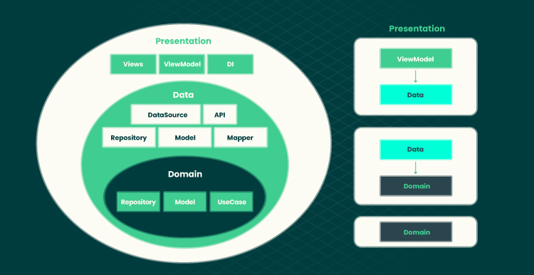
Figure 2: Show Android mobile Application Architecture flow and their layers

Slide 8
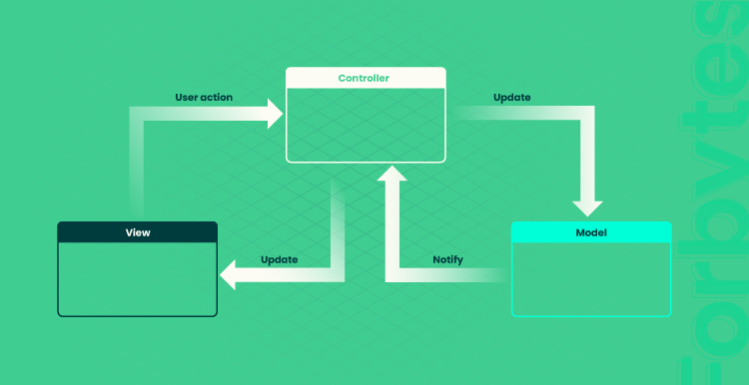
B-iOS Mobile App Architecture
Figure 3: Show iOS mobile application Mobile-View-Controller flow

Slide 9
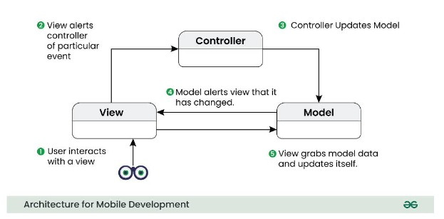
4.2-DESIGN PATTERNS
Design pattern are like building blocks that developers can use to solve common problems and create well-structure, maintainable code.
4.2.1-Most Frequency Design Patterns in Mobile Development with Examples and when to used it
a-Classic MVC or MVC (Model-View-Controller) Architecture
Figure 5: Classic MVC flow diagram

Slide 10
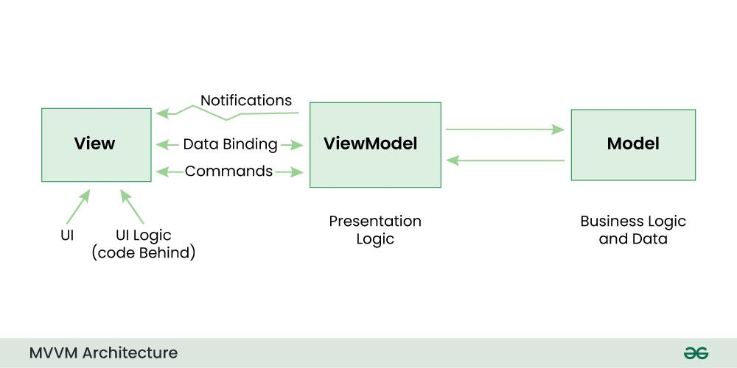
b-BAPPLE’S MVC ARCHITECTURE
Apple’s MVC (Model-View-Controller) architecture is a specific implementation of the classic MVC pattern tailored for iOS app development
C- MVMM (Model-View-View-Model) Architecture
Figure 6: show MVVM flow diagram

Slide 11
STUDY HOW TO COLLECT AND ANALYZE USER REQUIREMENTS FOR A MOBILE APPLICATION( REQUIREMENT ENGINEERING)
To collect and analyze user requirements for a mobile application effectively, a structured approach is crucial. Here is a comprehensive steps to follow:
Identify Stakeholders: Determine the key stakeholders who will be involved in the mobile application project..
Conduct User Research: Gather information about the target audience and their preferences.
Define Use Case and User Stories: Use cases and user stories help in capturing functional requirements from the user’s perspective.
Create Requirement Documentation: Document the collected requirements in a structured manner..
Prioritize and Validate Requirements: Prioritize the requirements based on their importance and feasibility
Review and Refine: Conduct regular reviews and iterations of the requirements to refine and improve them
Use Requirement Analysis Techniques: Apply various techniques to analyze the requirements such as feasibility analysis.
Document Assumptions and Constraints: Identify any assumptions made during the requirement gathering process and document them.
Maintain Traceability: Establish traceability between the requirement and other project artifacts, such as design, testing, and implementation.
Ensure Continuous Collaboration: Maintain Open Channels of communication with stakeholders throughout the requirement engineering process..

Slide 12
STUDY HOW TO ESTIMATE MOBILE APP DEVELOPMENT COST
Project Complexity : What the app will do and what needs, it will fulfill for the customers.
Complexity of app features: The complexity and number of features directly affect development time and cost
Target devices and platforms:Choosing between native and hybrid apps affects costs.
Native apps, specific to either Android or iOS, require separate development teams for each platform, doubling the cost, longer development cycles, and maintenance efforts for each platform
User Interface : A more complex user interface can require more design and development time, as well as additional testing and debugging which will affect the cost of development cost.
Third-party integration : Do the app that you are building need to be integrate with third-party services (like location sharing or payment).
Testing and Debugging : Once you finish building the app, you need to test it thoroughly to make sure it works as expected.
Hidden Costs of Developing an APP : App development can be a complex process that can be a lot of time, effort, and resources.

